Slide 1
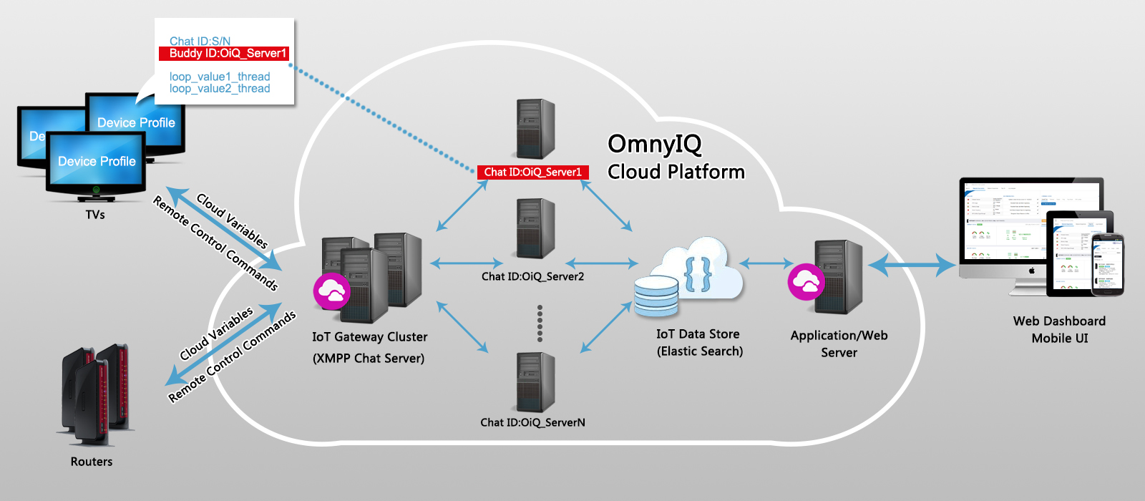


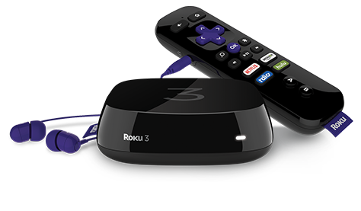
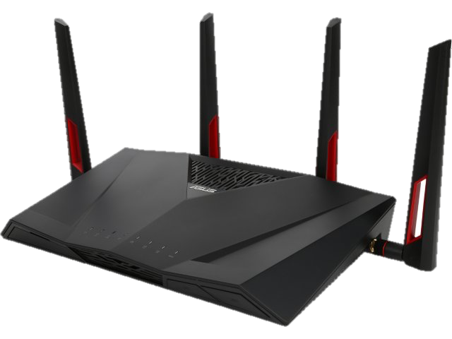
Omny IQ Cloud for Diagnostics and Analytics

Slide 2
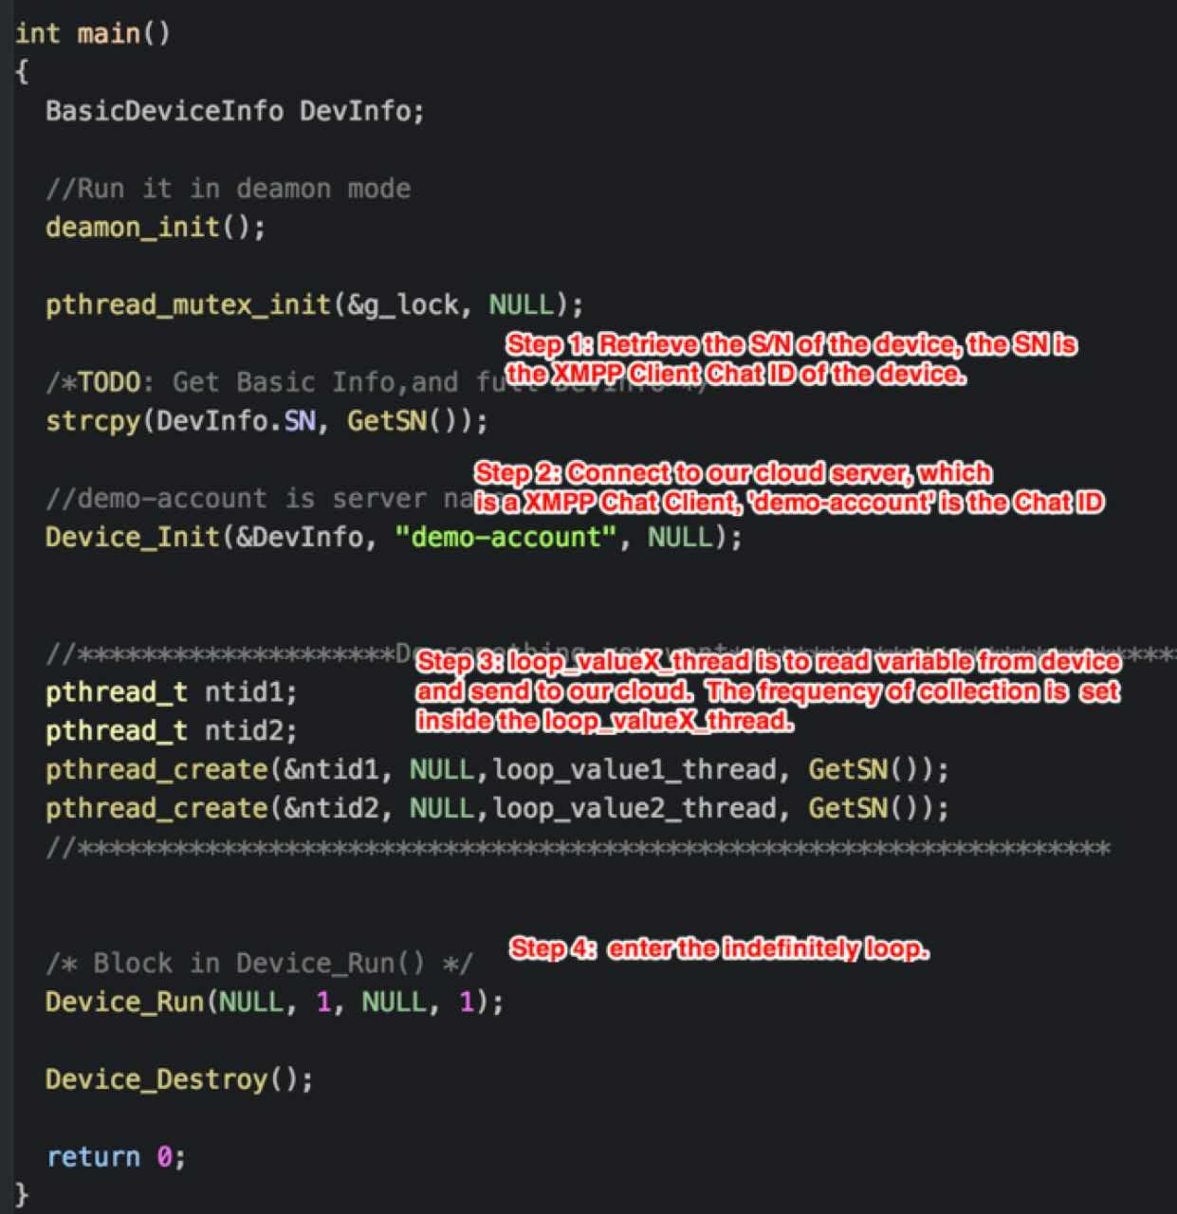
Device Profile
< 100 lines of code
25 ~ 200 KB space
No CPU overhead
Secure & encrypted

Slide 3
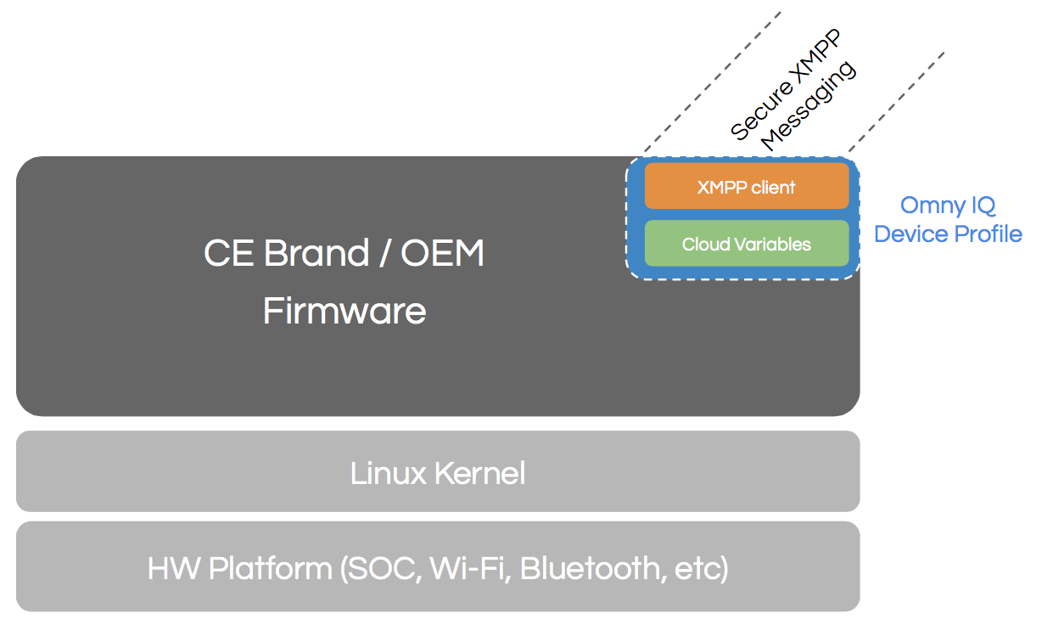

Slide 4
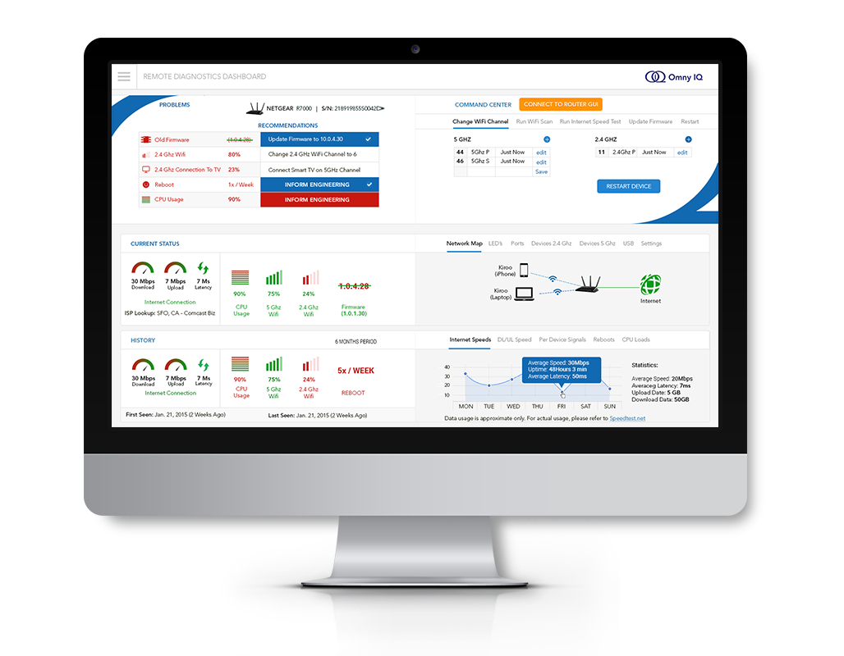


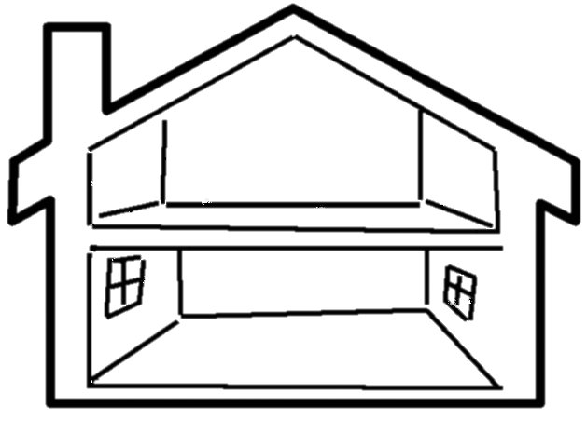
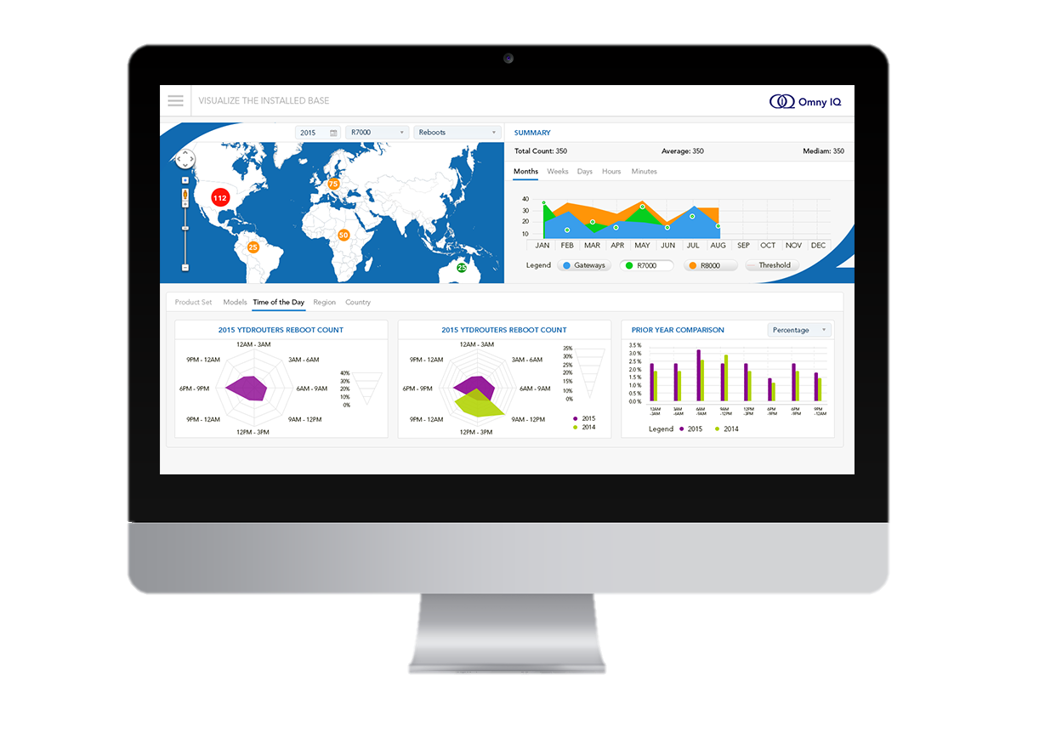
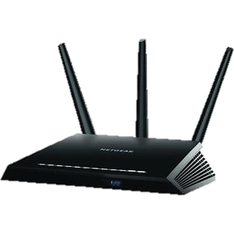
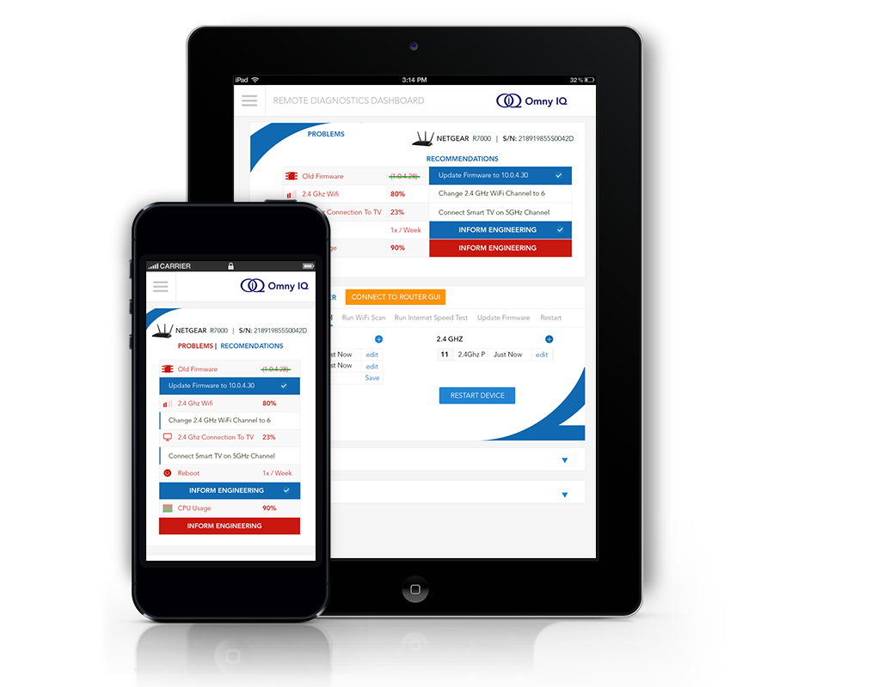

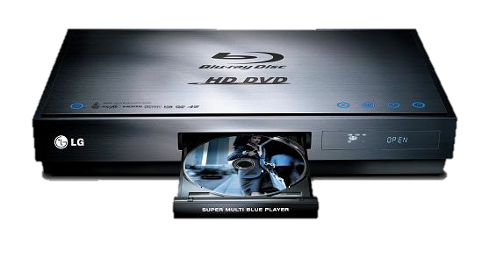
Omny IQ responsive diagnostics, visualization and actions
2. Real-time Cloud Analytics
1. Device Profiles
3. Actionable Dashboards

Slide 5







Omny IQ integrated full-stack solution
SQA Collaboration
Remote Diagnostics
Preventive Care
Self Care
Analyze .....
Store .……………………
Collect …….
Brand / ODM / IC Tech Support R&D / Ops / PM User
Omny IQ Cloud Database
& Analytics Engine
Real-time and
Bi-directional
IOT
device
content servers
Internet
router
apps

Slide 6

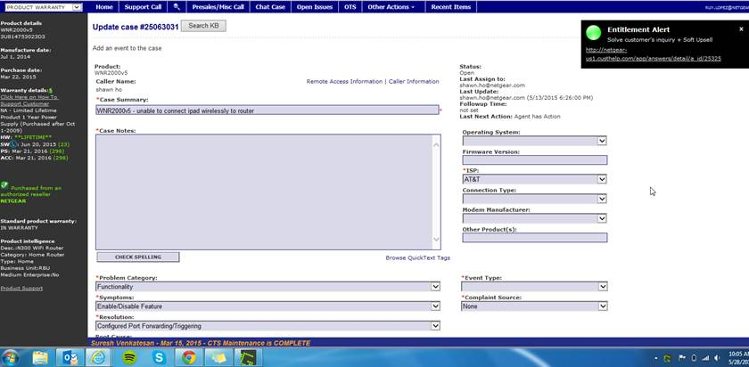
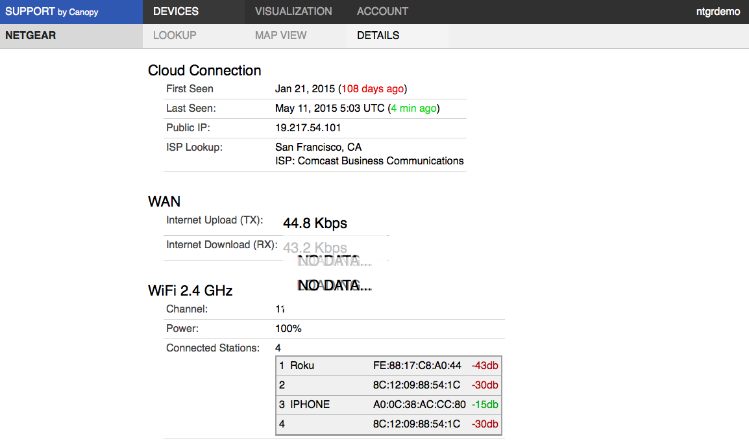
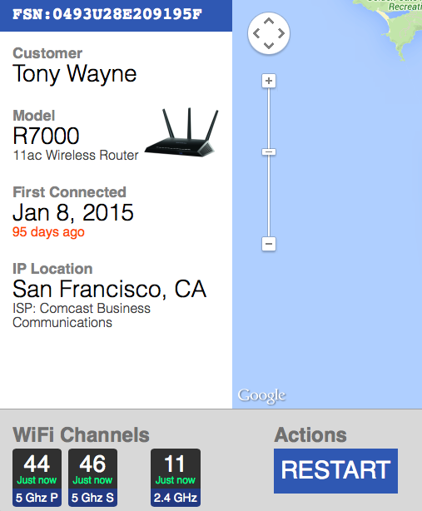
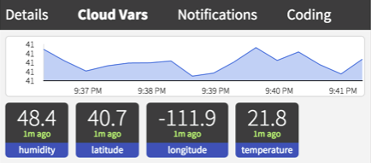
Existing Tech Support process
Consumer
Support Center
Brand’s Customer Tracking System
Omny IQ, Inc. CONFIDENTIAL

Slide 7
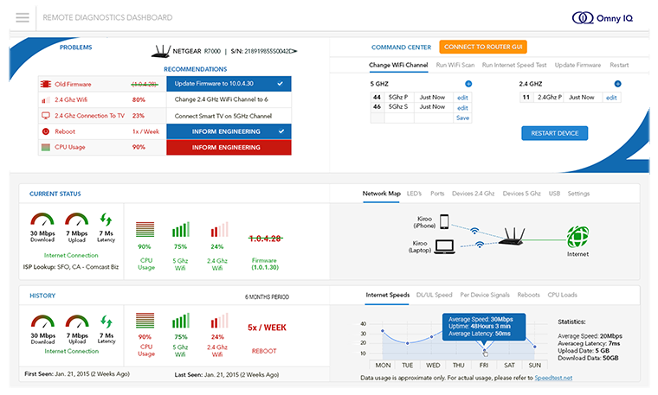
Directly access devices instead
Consumer
Real-Time IOT
Cloud Analytics
Support Center
Omny IQ Dashboard
Omny IQ, Inc. CONFIDENTIAL

Slide 8
Remote Diagnostics Dashboard
Top 5 Problems
Remote control
Actionable
recommendations
Real-time status
Network map
Historical log data
Omny IQ, Inc. CONFIDENTIAL

Slide 9
Preventive Care of Installed Base
Filter by product class/name/model,
date period
Clear summary
Geographic views by permission
Multiple period Comparison
Deep-dive tabs
Omny IQ, Inc. CONFIDENTIAL

Slide 10







Correlating information to Fault Isolate, Detect and Remediate
pending patent
What is the condition of the broadband/cellular services and access to Internet applications?
Are the WiFi signals clear?
Are other devices & applications impacting performance?
Is the device connected and working normally?
Internet
Conditions
Internet
Local
Environmental
Conditions
router
Device
Conditions
IOT
device

Slide 11


Serious Security / Privacy
SECURITY
CSA STAR Compliance
Transport Layer Security ~256-bit
encryption (XMPP, MQTT) & SSL
IOT Auth
PRIVACY
Detailed Privacy Policy
No Personal Information
No Usage Tracking
Opt Out

